Slide 1
CS100 Tutorial 11
Hands-on small projects

Slide 2
Task 1
Implement a calculus for expressions
Binary tree
Stack
Tokenizer
Expressions:
Operators ‘+’, ’-’, ’*’, ’/’ , ‘(‘ and ‘)’
Constants: integer and float

Slide 3
Binary Tree
A (binary) tree T=(N,E) is a non-linear abstract :
N: is a finite set of nodes
E: is an edge function mapping each node to a list consisting of at most two nodes
the first node in the list E(n) is called left child of n (if it exists)
the second node in the list E(n) is called right child of n (if it exists)
A node n is called root, if E(n’) does not contain n for all nodes n’ in N
A node n is called leaf, if E(n) is an empty list

Slide 4
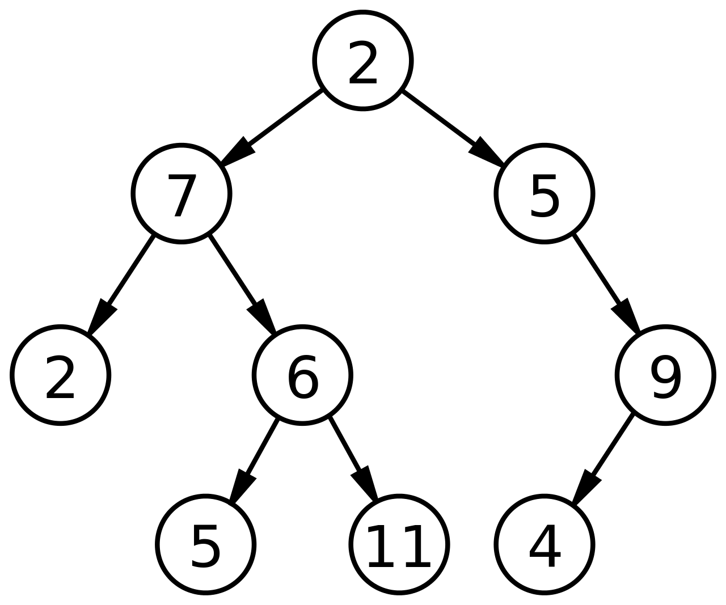
Example: A binary tree
root
leaf
leaf
leaf
leaf

Slide 5
Tree Representation
Tree class
define a class called Tree
the class has an instance attribute data (i.e., list or tuple) for representing data associated to the node
the class has two instance attributes called left and right for storing the left child and right child (that are tree instance objects)
class Tree():
def __init__(self, data, leftChild = None, rightChild =None):
self._data=data
self._leftChild = leftChild
self._rightChild = rightChild

Slide 6
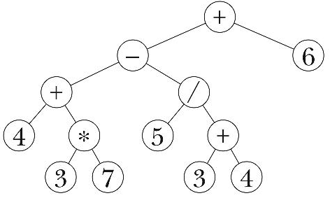
Representing an Expression as a Tree
An expression can be represented by a tree, where
leaves denote operands
other nodes denote operators
each subtree denotes an subexpression
(4+(3*7)) - (5/(3+4))
(4+(3*7)
5/(3+4)
3*7
3+4
Tree for the expression: ((4+(3*7)) - (5/(3+4))) +6

Slide 7
Representing an Expression as a Tree
class Tree():
def __init__(self, data, leftChild = None, rightChild =None):
self._data=data
self._leftChild = leftChild
self._rightChild = rightChild
# create a tree for 4 + (3 * 7)
t3 = Tree(3)
t7 = Tree(7)
t37 = Tree("*", t3, t7)
t4 = Tree(4)
t437 = Tree("+", t4, t37)

Slide 8
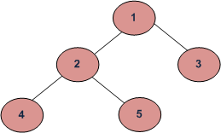
Tree Traversal
Inorder: visit left substree, then root, later right subtree
4 2 5 1 3
Preorder: visit root, then, left substree, later right subtree
1 2 4 5 3
Postorder: visit left substree, then right subtree, later root
4 5 2 3 1

Slide 9
Tree Traversal
class Tree():
……
def inOrder(self):
if self._leftChild!=None:
self._leftChild.inOrder()
print(self._data)
if self._rightChild!=None:
self._rightChild.inOrder()
def preOrder(self):
print(self._data)
if self._leftChild!=None:
self._leftChild.preOrder()
if self._rightChild!=None:
self._rightChild.preOrder()

Slide 10
Tree Traversal
class Tree():
……
def preOrder(self):
print(self._data)
if self._leftChild!=None:
self._leftChild.preOrder()
if self._rightChild!=None:
self._rightChild.preOrder()
def postOrder(self):
if self._leftChild!=None:
self._leftChild.postOrder()
if self._rightChild!=None:
self._rightChild.postOrder()
print(self._data)

Slide 11
Computing an expression via Postorder Traversal
Compute 4
Compute 3
Compute 7
Compute 3*7
Compute 4+(3*7)
Compute 5
Compute 3
Compute 4
Compute 3+4
Compute 5/(3+4)
Compute (4+(3*7)) – (5/(3+4))
Compute 6
Compute ((4+(3*7)) – (5/(3+4)))+6

Slide 12
Stack
Stack: is an abstract data structure, served as a collection of elements
a list-like object with two ends called bottom and top
Last in first out (LIFO)
basic operations: push, pop, peek on top of stack
Stack can be implemented using list type s
index 0 is the bottom, and index -1 is the top
empty stack: [ ]
push: s.append(e)
pop: s.pop()
top: s[-1]
Notes:
Why not index 0 is the top, and index -1 is the bottom?
For efficient consideration, constant time push and pop operations using index 0 as the bottom, and index -1 as the top

Slide 13
Tokenize
tokenize module provides a lexical scanner for Python source code, implemented in Python
import tokenize first
tokenize.tokenize(readline): readline, which must be a callable object which provides the same interface as the io.IOBase.readline() method of file objects. It can be obtained from a string via
BytesIO(s.encode('utf-8')).readline
return a 5-tuples:
the token type;
the token string;
a 2-tuple (srow, scol) of the row and column where the token begins;
a 2-tuple (erow, ecol) of ints where the token ends in the source;
the line on which the token was found

Slide 14
import tokenize
from io import BytesIO
import token
s = "(4.2+3)*2"
tokens = tokenize.tokenize(BytesIO(s.encode('utf-8')).readline)
for tokType, tokVal, _, _, _ in tokens:
if tokType == token.OP: print("OP: ",tokVal)
if tokType ==token.NUMBER: print("NUMBER: ",tokVal)
Output:
OP: (
NUMBER: 4.2
OP: +
NUMBER: 3
OP: )
OP: *
NUMBER: 2

Slide 15
Expression to Tree
Input: an expression create two empty stacks: opStack and exprStack
Create a new string s = “(”+input +”)”, then tokenize s
For each valid token t of an expression from left to right:
2.1 If t is “(”, push it onto the opStack.
2.2 If t is “)”:
2.2.1 while opStack.top != “(”:
op = opStack.pop()
right = exprStack .pop()
left = exprStack.pop()
expr = Tree(op, left, right)
push expr onto exprStack
2.2.2 Remove “)” from opStack.
2.3 If t is an operand, push Expr(Tree(t)) onto exprStack
2.4 If t is an operator:
2.4.1 While opStack.top has equal or higher precedence than t:
Do the same as in a)—e)
2.4.2 Push t onto opStack
opStack.top is the tree of the input expression

Slide 16
((4+3*6)/7*5)
*
+
Tree(6)
4
(
Tree(3)
(
Tree(4)
3
6

Slide 17
((4+3*6)/7*5)
+
*
4
(
T(*,T(3),T(6))
(
Tree(4)
3
6

Slide 18
((4+3*6)/7*5)
+
*
4
(
(
T(+,T(4), T(3*6))
3
6

Slide 19
((4+3*6)/7*5)
/
+
7
*
4
/
T(7)
(
T(4+3*6)
3
6
T(/,T(4+3*6),T(7))

Slide 20
((4+3*6)/7*5)
/
5
+
7
*
4
*
T(5)
(
T(/,T(4+3*6),T(7))
3
6

Slide 21
((4+3*6)/7*5)
*
/
5
+
7
*
4
(
T(*,T((4+3*6)/7),T(5))
3
6

Slide 22
Requirement
Using binary tree, stack, tokenizer to implement a module calc.py for computing values of expressions.
Testcases:
python calc.py “3+4”
7
python calc.py “(3+4)/2”
3.5

